Slide 1
Welcome to I399
00
Course Introduction & Syllabus Highlights

Slide 2
The basic schedule (subject to adjustments):
Week 1: HTML / Validation Week 2-3: The Box Model (CSS) Week 4-5: Design, Typography, Color, Images Week 6: Navigation & Usability Week 7-8: Modular Web Design Week 9-10: Responsive Web Design Week 11-13: Frameworks Week 14: JS Plugins Week 15: Project presentation / Work time
In general, coding projects will be due on Wednesdays at midnight.
Other projects will be due on Fridays at midnight.
All assignments will be announced with a minimum of a week to two weeks notice.

Slide 3

Course Book
Bookstore
Amazon or B&N
Kindle / e-reader
Read this book for a quiz and project due in the middle of the semester.

Slide 4

Additional Resource
Amazon or B&N
If you don’t have a background in graphic design… if you have never taken a design course before… this is a reasonable start.

Slide 5
How you will be evaluated:
CODING
Three quizzes on HTML and CSS knowledge.
Six increasingly complicated coding projects.
A design / content plan.
A final website and reflection essay.

Slide 6
How you will be evaluated: (cont…)
USABILITY
Quiz on the Krug book, a “Krug Kwiz” if you will
Usability report
EVALUATING WEBSITES / UNDERSTANDING THE WEB
Website Critique
Discussions / Responses on a few key topics

Slide 7
Grading
Participation / Quizzes / Readings / Usability Report . . . . . . 30%
Projects . . . . . . 35%
Final Project & Reflection Essay . . . . . . 35%

Slide 8
Final Assessment (subject to adjustments): Due Sunday, April 31 Create a responsive website using HTML5, CSS3 & Bootstrap
Showcase your ability to create online content and structure… Use Bootstrap4 (HTML5/CSS3) and ensure your design is a valid, responsive multi-page website with a modern design and with consideration for usability and user experience.
Plan • Code • Design • Problem-Solve • Understand Audience and User Experience • Evaluate your Work

Slide 9
Is this course for me?
Do you have limited to no experience outside of 101 (and perhaps 211) with HTML and CSS, but would like to be able to create a web interface?
Do you want to be able to better understand web technologies and the essentials required for sites / interfaces on the web?
Do you have experience, but want to have time this semester to hone your web skills and have a class that allows you to work on a website project?
YES

Slide 10
Is this course for me?
Did you sign up because you believed this will be an easy course?
Do you want to learn JavaScript and aren’t interested in web interfaces?
Would you rather learn from an online service like Code Academy?
NO

Slide 11
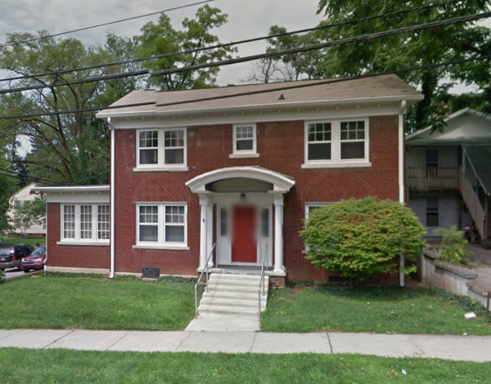
Office Hours
611 N Woodlawn Ave
Office hours will be announced by the end of the week. If you need help before that, or have questions, please email one of your instructors to set an appointment.

Slide 12
Your Instructors
Erika Lee, ebigalee@indiana.edu
Andrew Jones (MS,HCI), andcjone@indiana.edu
Dimas MacDonald (UI,INFO), dimacdon@indiana.edu
Jared Peterson (UI,INFO), jarepete@indiana.edu
Tingyu (“Karen”) Li (MS,HCI), litin@indiana.edu
Nirmal Patel (UI,INFO), nirmpate@indiana.edu

